Slide 1

Senate Elections and Constitutional Amendments Committee
Assembly Elections Committee
Joint Hearing
“Artificial Intelligence and Elections: Protecting Democracy in the Digital Era”
Liz Howard, Brennan Center for Justice

Slide 2
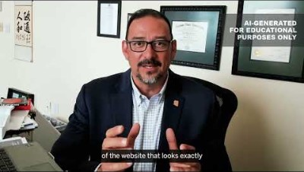
ELECTION OFFICIAL DEEPFAKED IN A PUBLIC POST
HOW IT COULD HAPPEN
A foreign adversary gathers publicly available video of an election official and uses the audio and visuals to train an AI system. With this training, the adversary can create a deepfake video depicting the official giving false information designed to trick voters, including falsehoods about how to vote. It could be targeted at members of a specific political party, gender, race or ethnicity. This deepfake is an AI version of Arizona Secretary of State Adrian Fontes and was produced as part of a statewide election security tabletop exercise with his consent and cooperation.

Slide 3
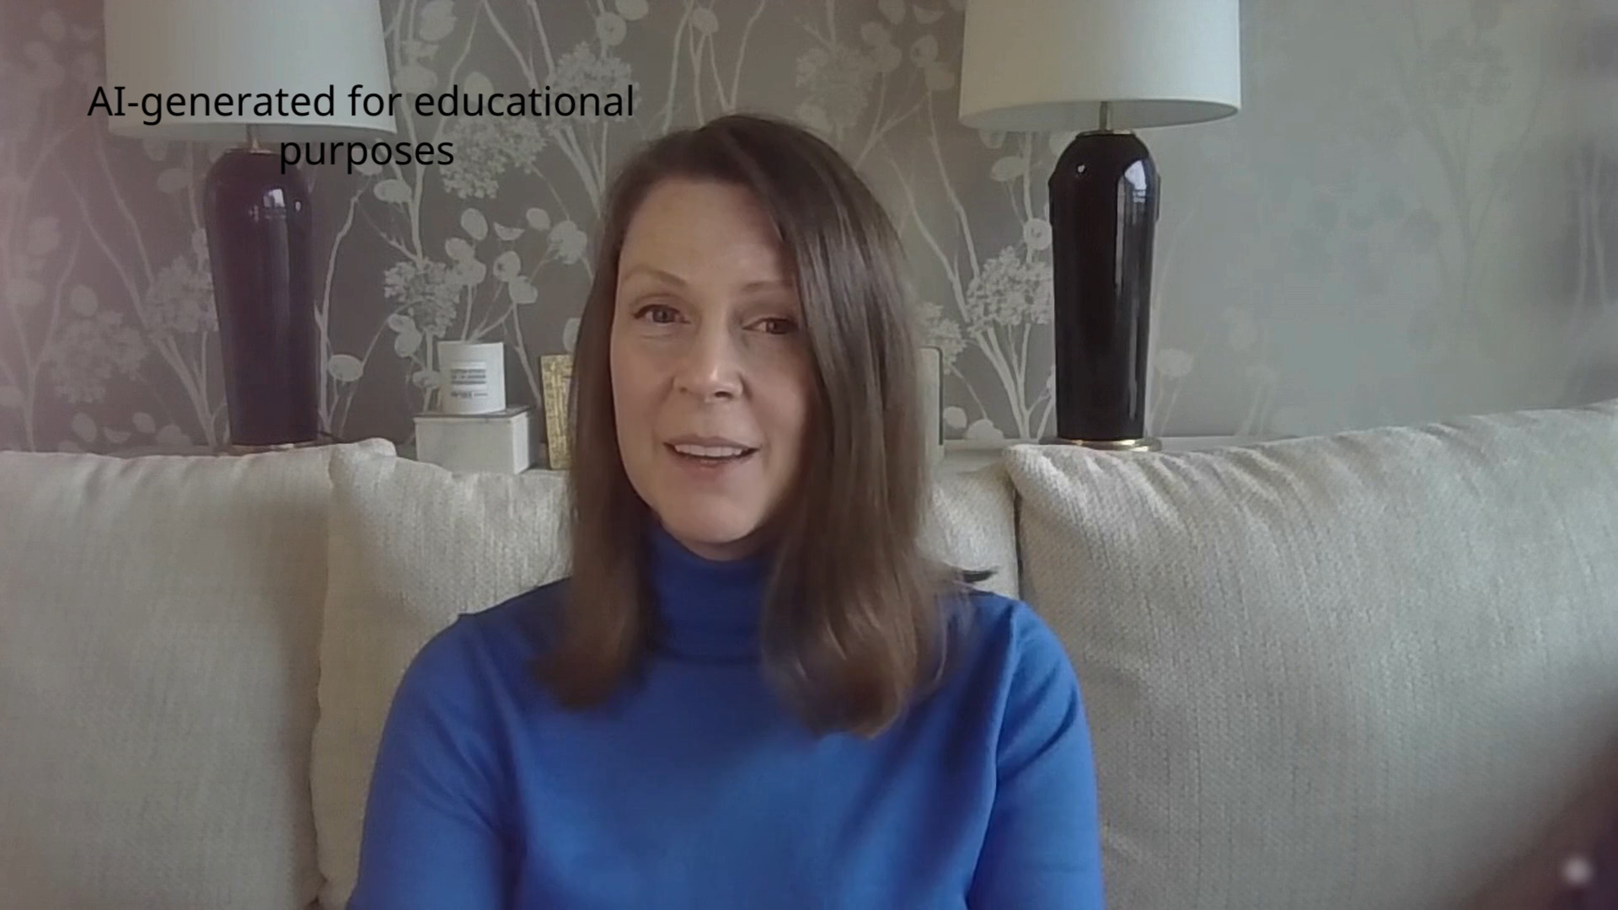
ELECTION OFFICIAL DEEPFAKED IN A PUBLIC POST

Slide 4
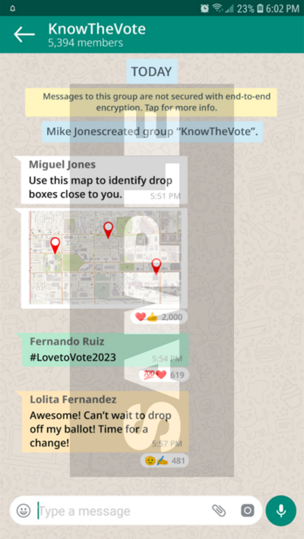
PUBLIC INTENTIONALLY MISINFORMED ABOUT WHERE TO VOTE
HOW IT COULD HAPPEN
A large WhatsApp group chat displays inaccurate drop box locations throughout a county. The information seems to be spreading fast among the local Latino population.

Slide 5
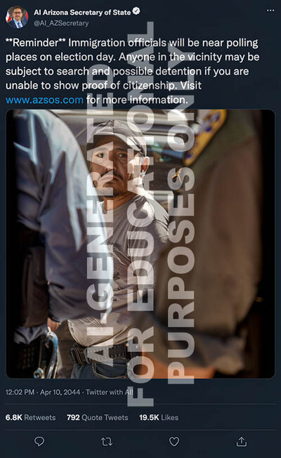
FALSE REPORTS WARN OF ICE SHOWING UP AT POLLING PLACES
HOW IT COULD HAPPEN
A fake post purporting to originate from the election office says that people without citizenship documentation may be subject to detention and interviews from ICE if they are at or near a polling place. The post appears as a social media screenshot and includes a fake website that looks just like the election office website but ends in .com instead of .gov. The account itself uses an official-sounding username and even has platform verification, which is available to purchase on specific platforms.

Slide 6
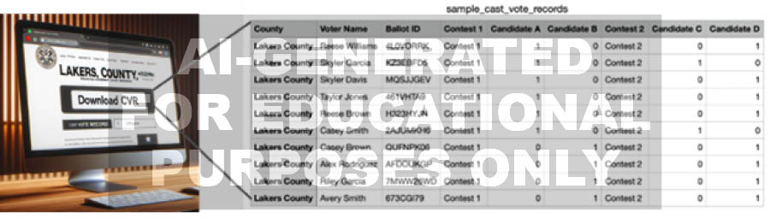
ELECTIONS WEBSITE SPOOFED WITH FAKE RESULTS
HOW IT COULD HAPPEN
A county elections website is spoofed and fake cast vote records with names of individuals are posted. Numerous groups from both parties are up in arms that this occurred. Election officials suspect that ChatGPT or a similar tool was used to create this phony website.

Slide 7
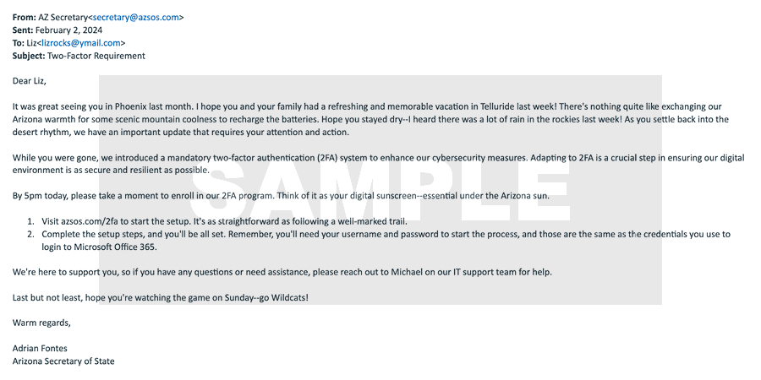
HACKERS SEND TEXTS OR EMAILS PHISHING FOR CREDENTIALS
HOW IT COULD HAPPEN
Election officials receive fake emails from people pretending to be with the secretary of state’s office or the Department of Homeland Security directing them to configure two-factor authentication for the state election system. The AI-generated messages appear particularly convincing because they contain sensitive information and they use language appropriate to the region. In reality, although the messages look personalized and handcrafted, they are based on stolen databases and information publicly available on social media.

Slide 8

VOICE-CLONED AUDIO MISINFORMS ELECTION WORKERS ABOUT POLLING PLACE HOURS
HOW IT COULD HAPPEN
An AI-generated voice clone of an election official is used to leave a voicemail for election workers, telling them that the office has received a court order to keep the polls open for an extra hour.

Slide 9
PHONE LINES JAMMED WITH AI-GENERATED CALLS
HOW IT COULD HAPPEN
The election office phone line and staff’s cell phones begin receiving regular calls asking questions about the election, such as polling place hours, addresses, and details about ballots and how to fill them out. Each call individually could be a real constituent, but the number of calls overwhelms staff resources and is far beyond what the office has seen before. When asked to identify themselves, the callers use names from actual voter rolls. Occasionally, there are suspiciously long pauses during the calls, and sometimes names of streets or last names seem to be pronounced strangely. The election office staff begins to suspect that the calls are AI-generated.

Slide 10

AI-GENERATED SOCIAL MEDIA POSTS CALL FOR ARMED PROTEST AT POLLING PLACES
HOW IT COULD HAPPEN
Angry and hostile posts are appearing at a rapid rate on social media, recruiting people to join protests. One post reads, “The fight for democracy is here! Fight off the deniers! Every vote must count! Protest starts at 8:00 a.m. at the vote counting center.” Another post that was flagged and quickly removed said, “End the fraud! End the corruption! Arm yourself and be ready to defend our freedom! Early voting protest TODAY!” Some of the accounts posting the content appear suspicious — they were created recently, and some contain images that on close inspection appear to be AI-generated.

Slide 11
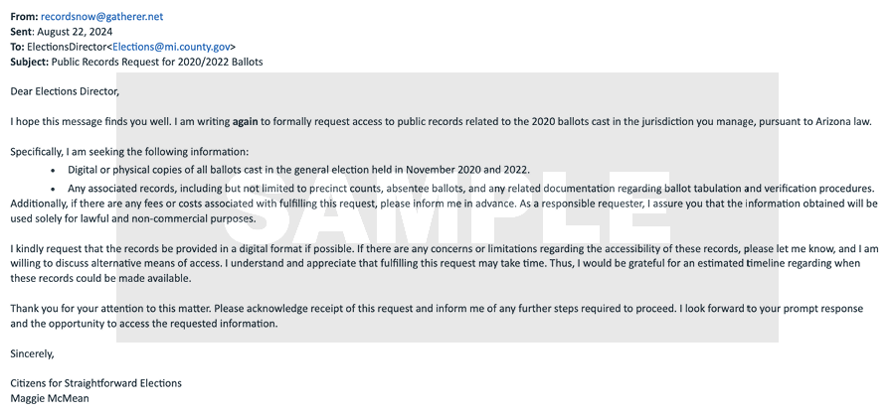
ELECTION OFFICES FLOODED WITH AI-GENERATED FOIA REQUESTS
HOW IT COULD HAPPEN
A local election office receives a series of Freedom of Information (FOIA) requests, each with slightly different wording, such that they each require different responses. They appear likely to have been generated by AI.

